Slide 1





RIMS MCA Major Project Group 3 – 18th June 2022
Internal Guide –
Lipika Rajanandini Sahu, Asst. Professor, RIMS, Rourkela
External Guide –
Biswaranjan Mandoi – Senior Manager, L&T Infotech, UK
Suvendu Mishra – Practice Lead, Cytiva, Bangalore

Slide 2
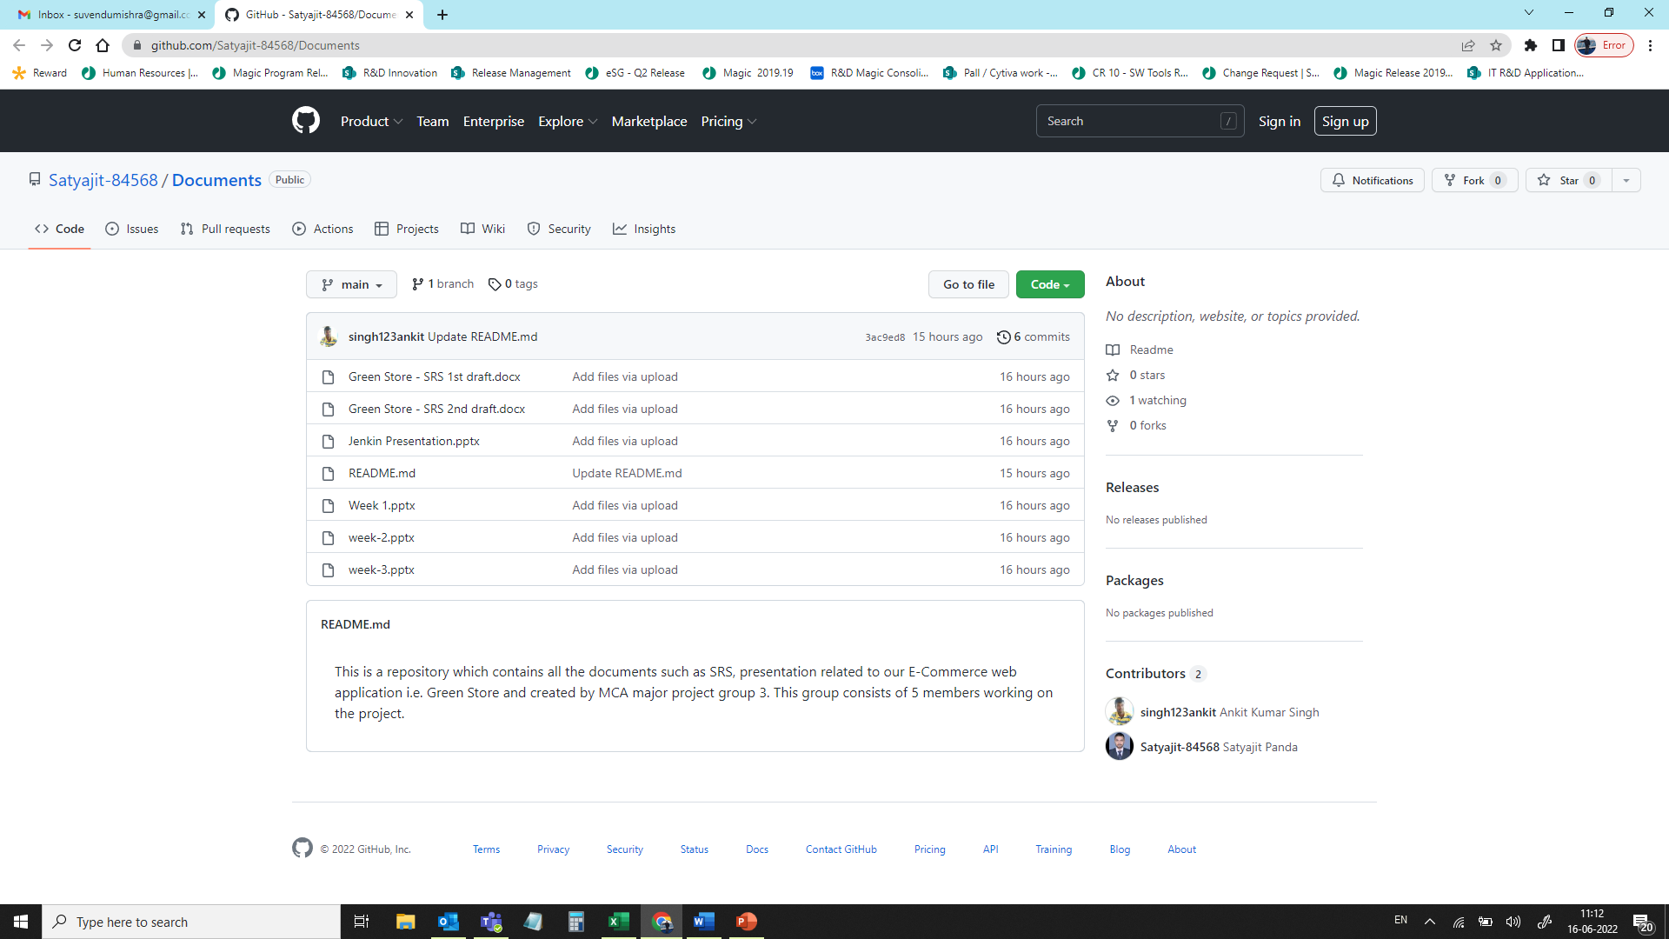
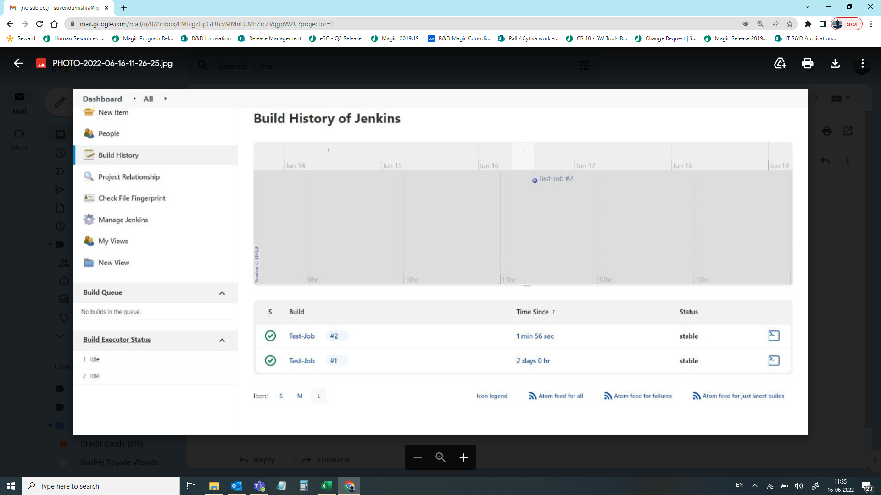
Summary – Green Store : An e-commerce application to sell different varieties of plant through B2B platform.
Accomplishment –
Review of SRS final version – Completed
Internal Training on Jenkins to project members by Ankit - Completed.
Created Project’s Document Repository using GIT/ GITHUB and extended access to all project members (https://github.com/Satyajit-84568/Documents) - Completed
Help Needed –
None for this week.
Plan for Next Week –
SRS Sign-off by all stakeholders.
Prepare the GANT Chart of the Project
Internal Training on GIT/ GITHUB/ Maven by Ananya & Amitesh
Schedule session with External Enterprise Architect to prepare the Use Case Diagram and Class Diagram of the project

